Slide 1
The Battle of Neighborhood - Scarborough
Capstone project
August, 2020

Slide 2
Background – Scarborough
Location: eastern part of Toronto
Population: over 630,000 (2016 census)
57% foreign-born
55.9% Asian
Business
Agrincourt: heavily concentration of Chinese businesses and restaurants
Cuisines from all of world are everywhere
The most diverse and multicultural area in the Greater Toronto

Slide 3
Business Problem
An investor plans to open a restaurant, what’s the answer for the following questions:
Target consumers
Market situation
Competing restaurants

Slide 4
Data
Wikipedia page: pull region information
https://en.wikipedia.org/wiki/List_of_postal_codes_of_Canada:_M
Geopy library
Latitude and longitude values
Foursquare API
It is a location data provider with information about all manner of venues
Information includes venue names, locations, latitudes, longitudes etc.
Within 1000-meter radius will be selected

Slide 5
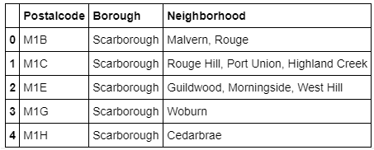
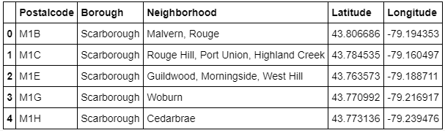
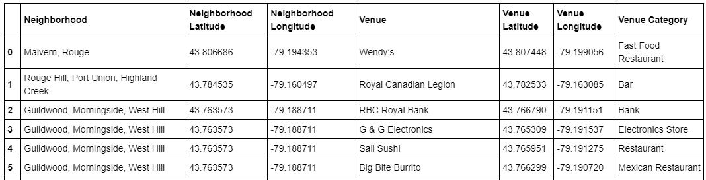
Methodology – data cleansing
Dataframe: Postalcode, Borough, and Neighborhood
Latitude and longitude will be merged with above table
Utilize Foursquare API to explore the neighborhoods

Slide 6
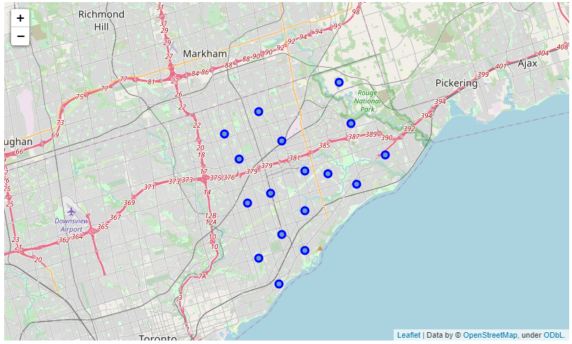
Methodology – data exploration

Slide 7
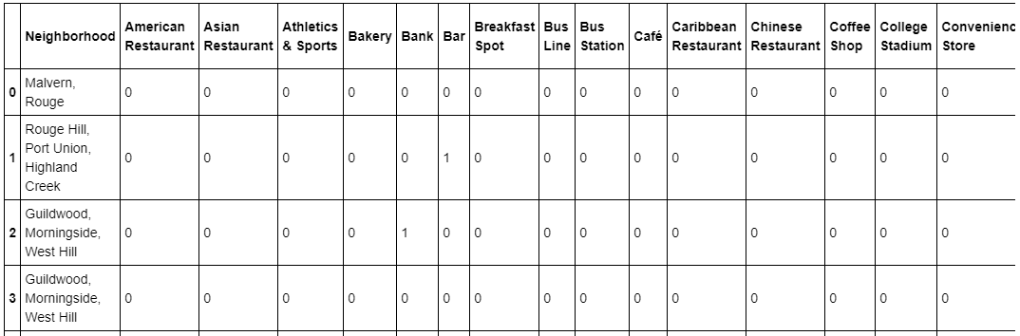
Methodology – Machine learning
One-hot encoding
Categorized data before fitting a ML model

Slide 8
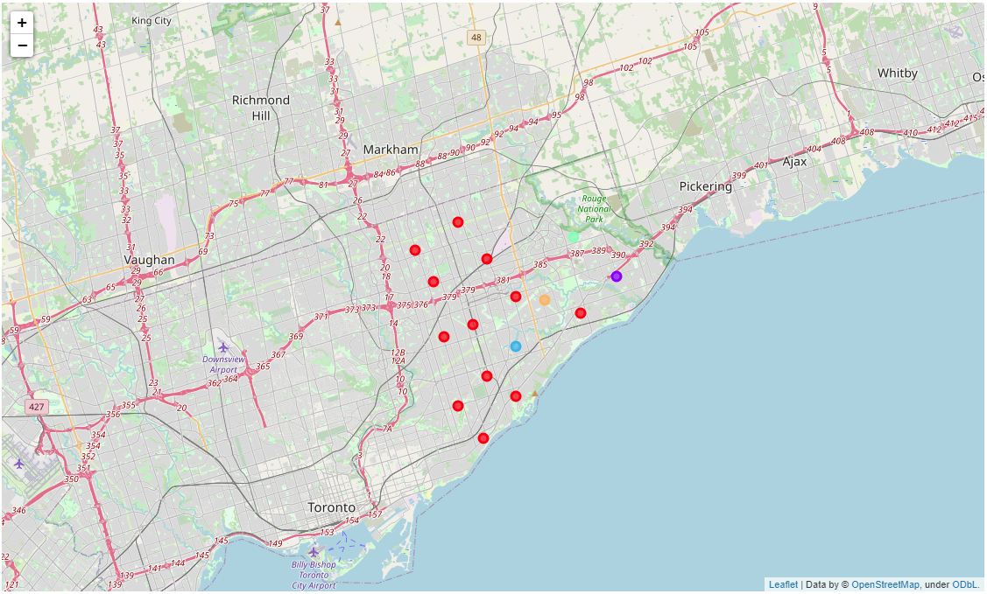
Methodology – Machine learning
K-mean clustering
5 clusters

Slide 9
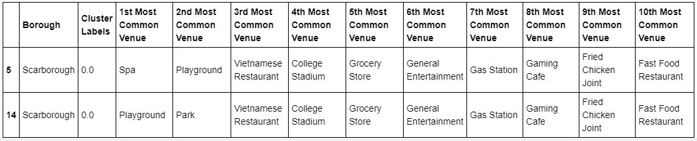
Methodology – data analysis
Cluster 1

Slide 10
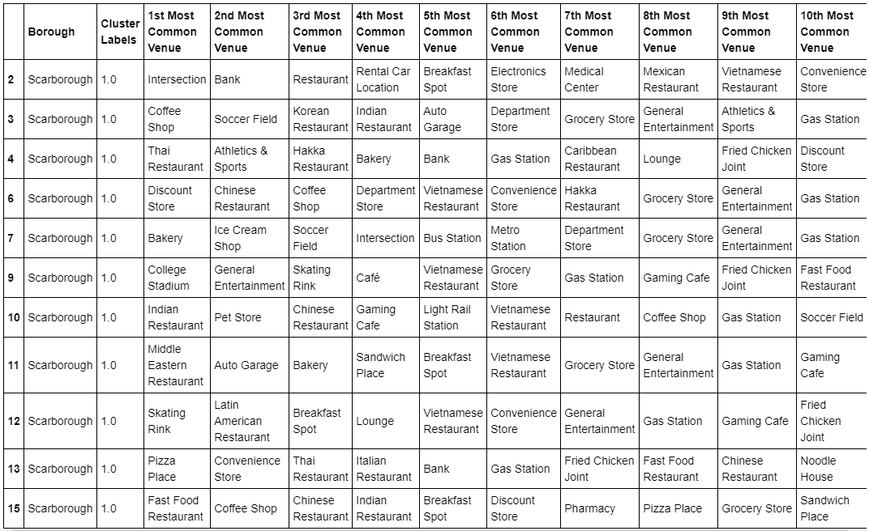
Methodology – data analysis
Cluster 2

Slide 11
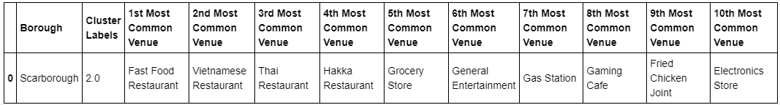
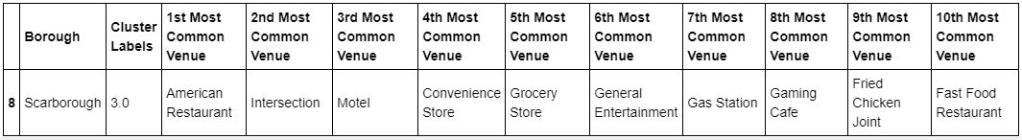
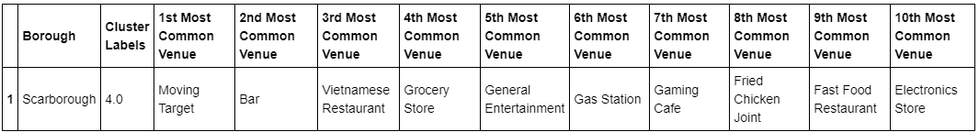
Methodology – data analysis
Cluster 3,4,5

Slide 12
Results
Cluster 2 has the most neighborhood
Cluster 1 has 2 and cluster 3, 4 and 5 has one neighborhood

Slide 13
Conclusions
Utilizing different data for analysis
Wiki page, Foursquare API
Machine learning used for clustering
One-hot encoding, K-mean clustering
Possibility to open a new restaurant in Scarborough
1st option: Golden Mile, Clairlea and Oakridge (neighborhood 7)
2nd option: Birch Cliff and Cliffside West (neighborhood 9)

Slide 14
Discussion
In neighborhood 7, no completion. Neighborhood 9, only 1 Vietnamese restaurant.
More factors could be considered for the research
Income, age, marital status, etc.

